Slide 1
Economics 144 Economic Forecasting
Lecture 4
Modeling and Forecasting Trend
(Part II)
Dr. Randall R. Rojas

Slide 2
Today’s Class
Forecasting Challenges
Forecasting Environments
Model Selection
MSE
AIC
SIC
Trend Fitting via Periodic Functions
Trend Fitting via Holt-Winters Filtering
R Example

Slide 3
Forecasting Environments
The data sample is divided into two parts: usually 2/3 are used for estimation and 1/3 for prediction.
Def: Estimation Sample
This sample is used for estimating the model and respective parameters.
Def: Prediction Sample
This sample is used to assess the accuracy of the forecast.
Forecasting Methods:
Recursive
Rolling
Fixed

Slide 4
Forecasting Challenges
Lack of understanding of the phenomenon
Lack of statistical methods
High uncertainty
Lack of integration of skills

Slide 5
Recursive Scheme
One-step ahead
prediction at
time t
Estimation sample
(t observations)
Prediction sample
0
t
t+1
T
Estimation sample
(t+1 observations)
Prediction sample
0
t+1
t+2
T
t +1
.
.
.
.
.
.
.
.
Estimation sample
(t+j observations)
Prediction sample
t +j
0
t+j
t+j+1
T
Model parameters are update one observation at a time.

Slide 6
Rolling Scheme
One-step ahead
prediction at
time
t
Estimation sample
(t observations)
Prediction sample
0
t
t+1
T
Estimation sample
(t observations)
Prediction sample
t +1
0
1
t+1
t+2
T
.
.
.
.
.
.
.
.
Estimation sample
(t observations)
Prediction sample
t+j
0
j
t+j
t+j+1
T
Model parameters are update using a fixed ‘window’ of observations.

Slide 7
Fixed Scheme
One-step ahead
prediction at
time
t
Estimation sample
(t observations)
Prediction sample
0
t
t+1
T
Estimation sample
(t observations)
Update
Prediction sample
t+1
0
t
t+1
t+2
T
.
.
.
.
.
.
.
.
Estimation sample
t observations)
Update information set
Prediction sample
t+j
0
t
t+1
…………
t+j
t+j+1
T
Model parameters computed only once

Slide 8
Model Selection _{1 of 9}
Among the various model fits, how do we select the best one?
Need a measure of “best fit model”.
There are many metrics used for model selection such as e.g., MSE, AIC, SIC, Mallows CP, etc.
Depending on the Forecast problem on hand, certain metrics will be better suited than others for choosing an optimal model.

Slide 9
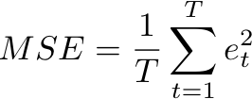


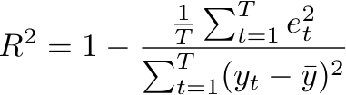
Model Selection _{3 of 9}
Mean Squared Error (MSE):
where and
The model with the smallest MSE is also the model with the smallest sum of squared residuals (maximizes R²).
Total sum of squares

Slide 10
Model Selection _{4 of 9}
As the number of parameters increases, the MSE performance deteriorates (overfitting)!
The out-of-sample forecast will not necessarily improve. However, it will improve the model’s fit on the historical data.
MSE is a biased estimator of the out-of-sample 1-step-ahead prediction error variance.
→The variance increases as the number of variables increases.
Need to include a penalty for including more degrees of freedom (variables)!

Slide 11

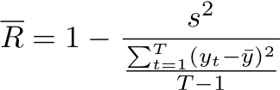
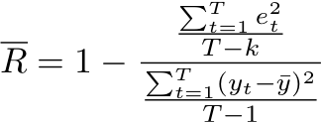
Model Selection _{5 of 9}
MSE (adjusted for df):
where k is the number of degrees of freedom (df) used in model fitting.
Adjusted R²:

Slide 12


Model Selection ₆ _{of 9}
Since:
Penalty Factor

Slide 13


Model Selection _{7 of 9}
Two popular model selection metrics are:
Akaike Information Criterion
Schwarz Information Criterion
Note: SIC is more commonly known as the Bayesian Information Criterion (BIC).

Slide 14
Model Selection _{8 of 9}
Consistency: A model selection criterion is consistent if
(a) when the data-generating process (DGP) is among the models considered, the probability of selecting the true DGP approaches 1 as the sample size increases.
(b) when the DGP is not among the models considered, the probability of selecting the best approximation to the true DGP, approaches 1 as the sample size increases.
MSE: inconsistent
AIC: biased towards overparameterized models
SIC: consistent
Asymptotic Efficiency: Rate of the model selection process
AIC: asymptotically efficient
SIC: not asymptotically efficient

Slide 15
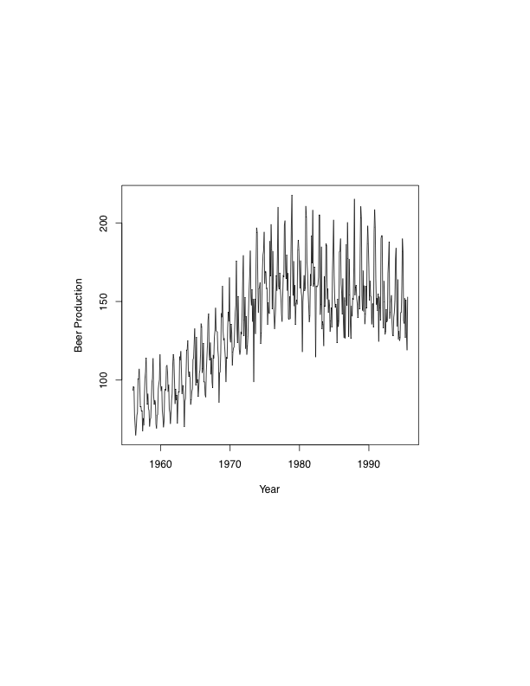
Example: Modeling and Forecasting Trend ₁ _{of 10}
Monthly Beer Production in Australia from Jan 1956 – Aug 1995
http://www.statoek.wiso.uni-goettingen.de/veranstaltungen/zeitreihen/sommer03/ts_r_intro.pdf

Slide 16
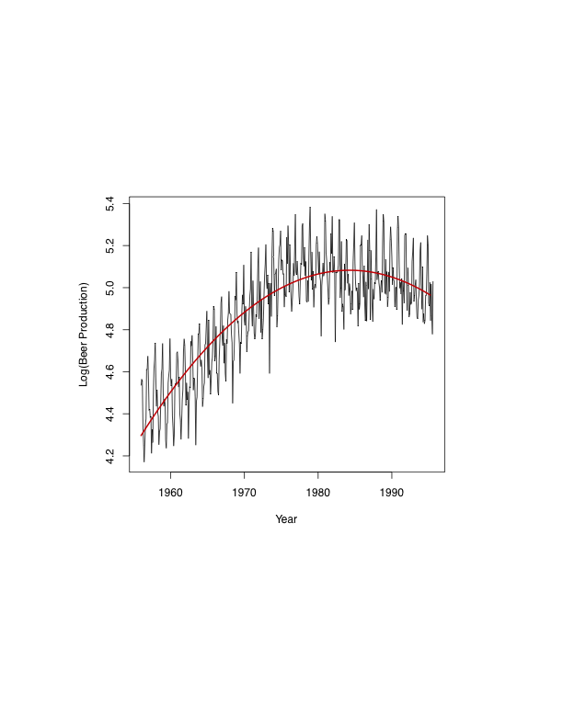
Example: Modeling and Forecasting Trend ₂ _{of 10}
Model 1:
(Quadratic)

Slide 17
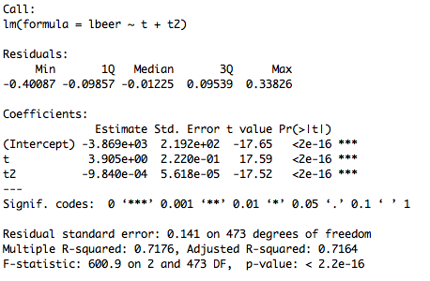
Example: Modeling and Forecasting Trend ₃ _{of 10}
Model 1 (Quadratic): Summary

Slide 18
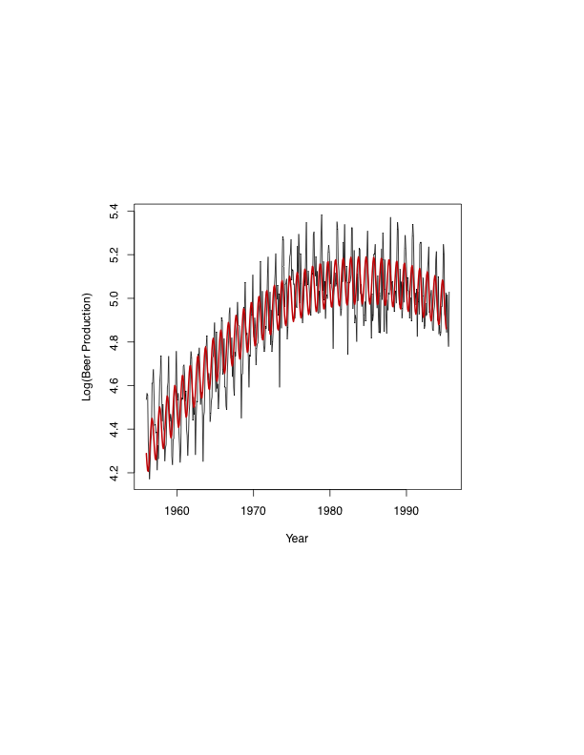
Example: Modeling and Forecasting Trend ₄ _{of 10}
Model 2:
(Quadratic + Periodic)
Add a periodic term.

Slide 19
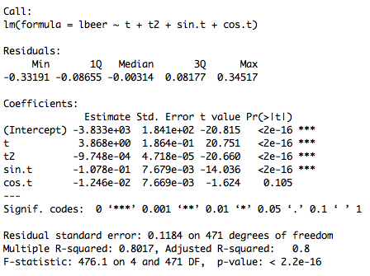
Example: Modeling and Forecasting Trend ₅ _{of 10}
Model 2 (Quadratic + Periodic): Summary

Slide 20
Example: Modeling and Forecasting Trend ₆ _{of 10}
Model 1 vs. Model 2
AIC (m1, m2) | df | AIC
Model 1 | 4 | -509.3847
Model 2 | 6 | -673.7203
Model 2 is better.
BIC (m1, m2) | df | BIC
Model 1 | 4 | -492.7230
Model 2 | 6 | -648.7278
Model 2 is better.
The smaller the value returned from AIC and BIC, the better the model.

Slide 21
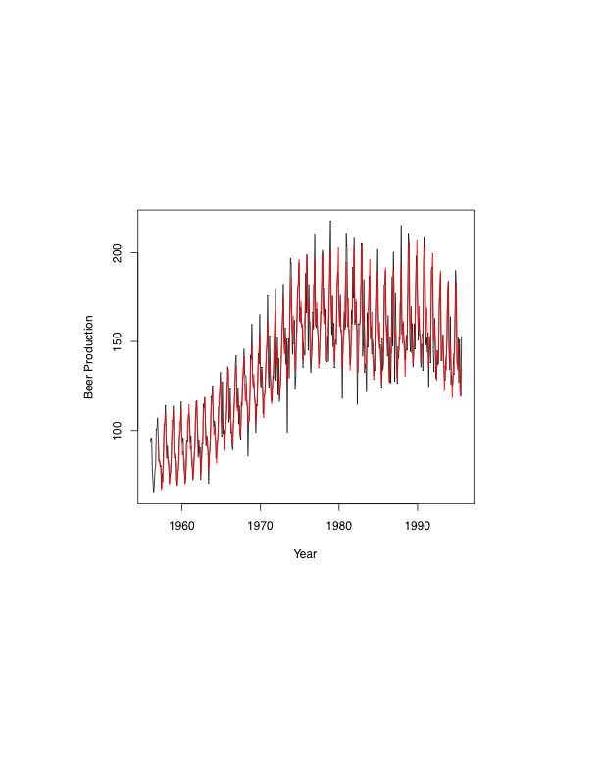
Example: Modeling and Forecasting Trend ₇ _{of 10}
Holt-Winters Filter: Considerably better model!

Slide 22
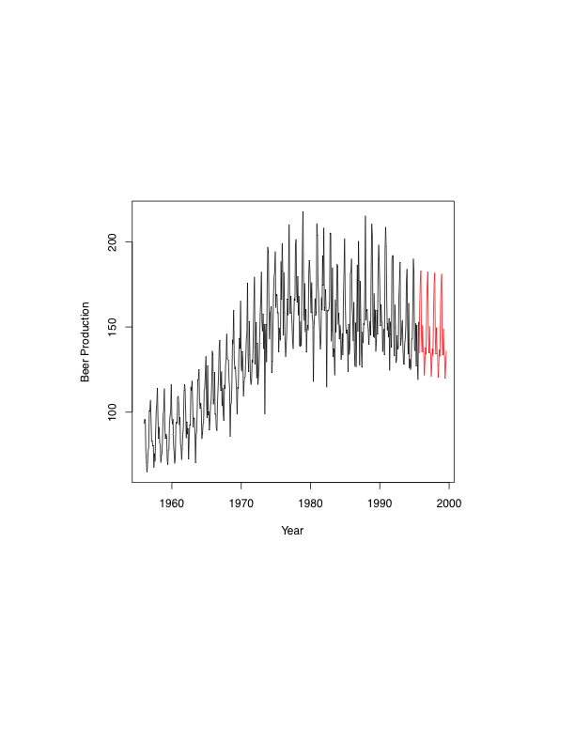
Example: Modeling and Forecasting Trend ₈ _{of 10}
Holt-Winters Prediction/Forecast for next 4 years
Forecast

Slide 23
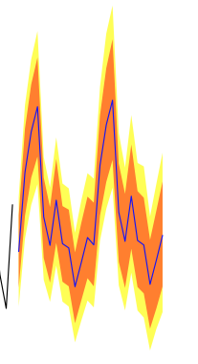
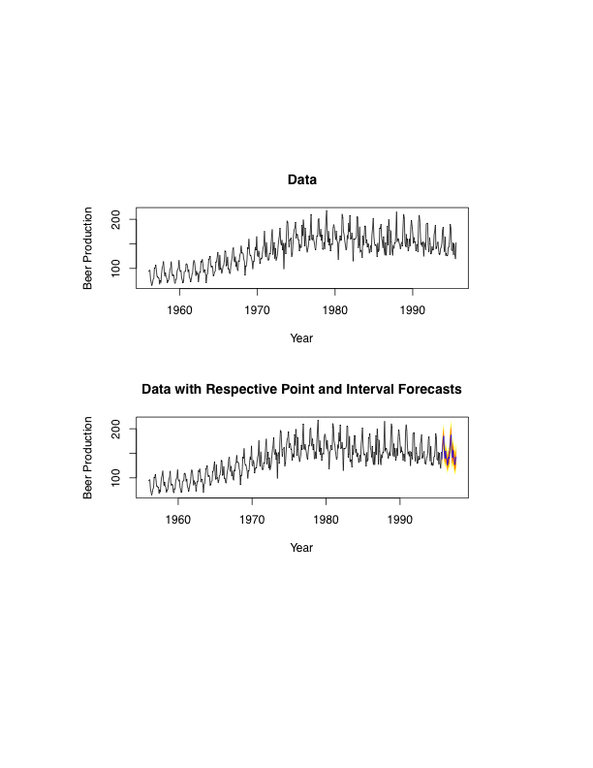
Example: Modeling and Forecasting Trend ₉ _{of 10}
Holt-Winters Point and Interval Forecast for next 4 years
Interval (95%)
Interval (80%)
Point forecast

Slide 24
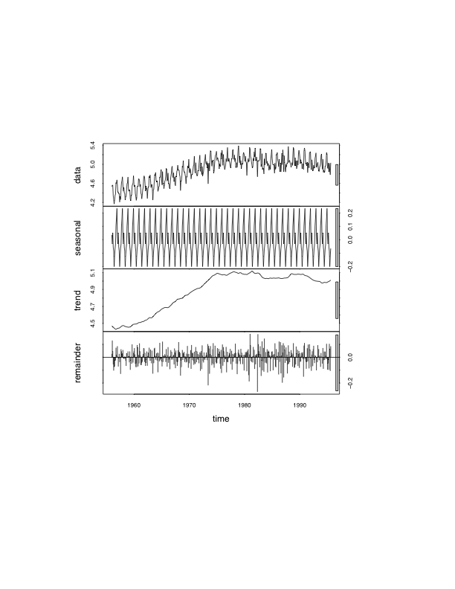
Example: Modeling and Forecasting Trend ₁₀ _{of 10}
Trend + Seasonal Components Decoupled

Slide 25
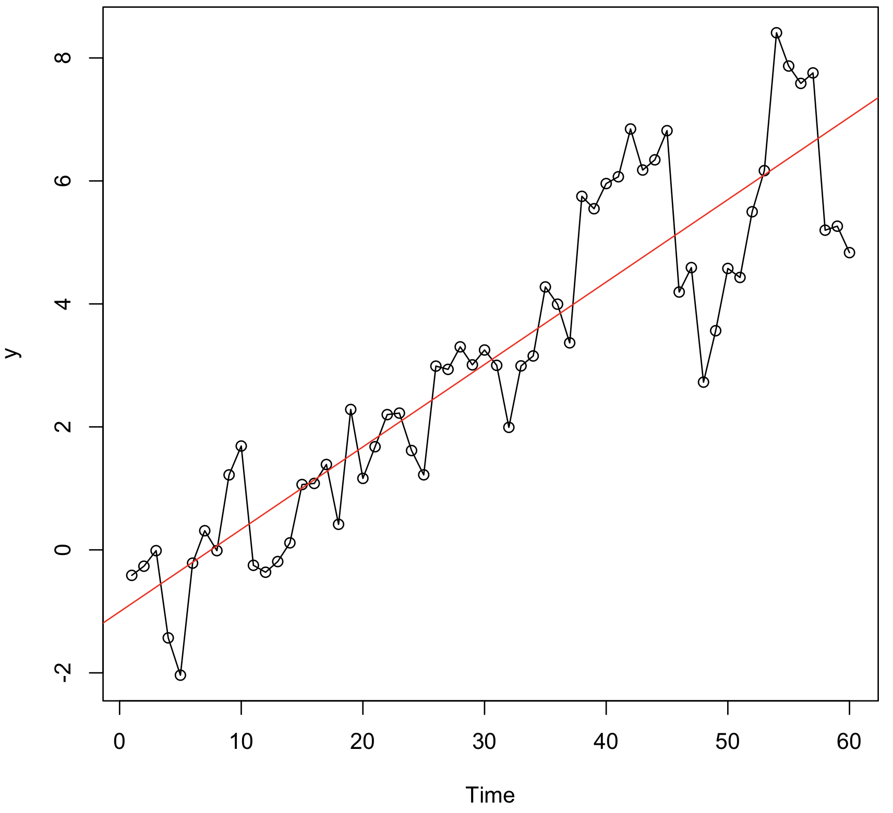
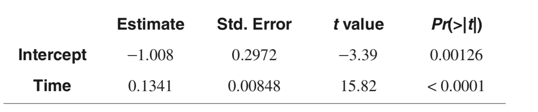
Modeling Trend Random Walk with Linear Time Trend
Notes:
library(TSA)
data(rwalk)
model1=lm(rwalk~time(rwalk))
summary(model1)
plot(rwalk,type='o',ylab='y')
abline(model1,col=“red”) # add the fitted least squares line from model1

Slide 26
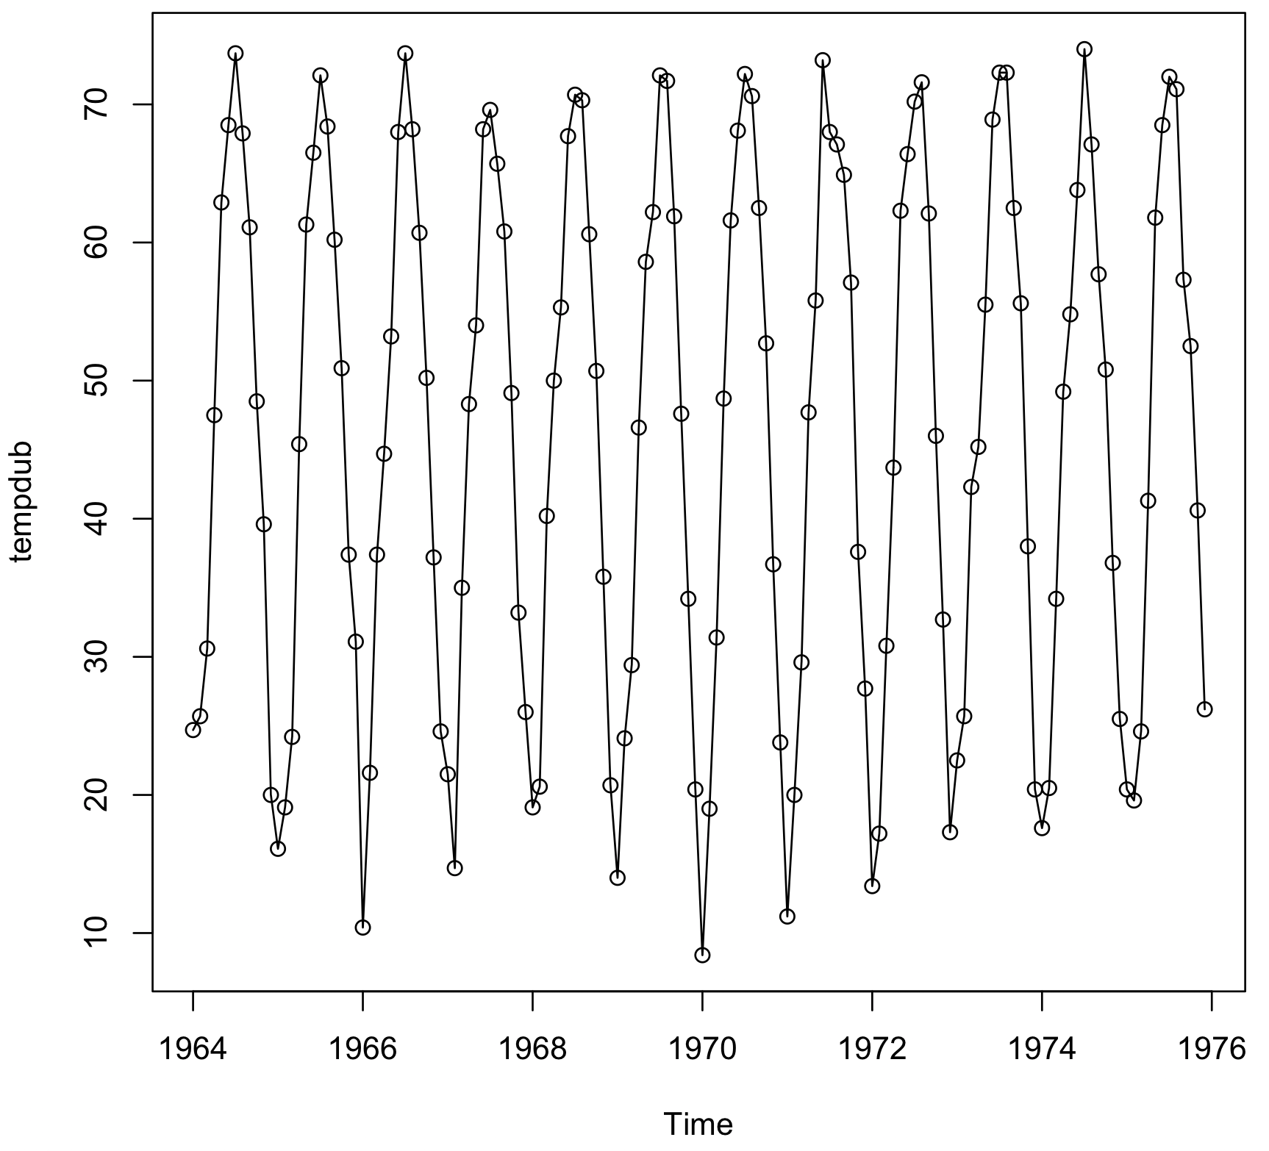
Modeling Trend Cyclical or Seasonal Trends
Notes:
library(TSA)
data(tempdub)
month.=season(tempdub) # period added to improve table display
model2=lm(tempdub~month.-1) # -1 removes the intercept term
summary(model2)

Slide 27
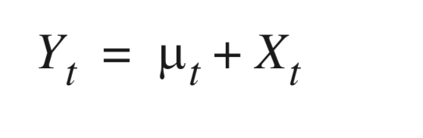
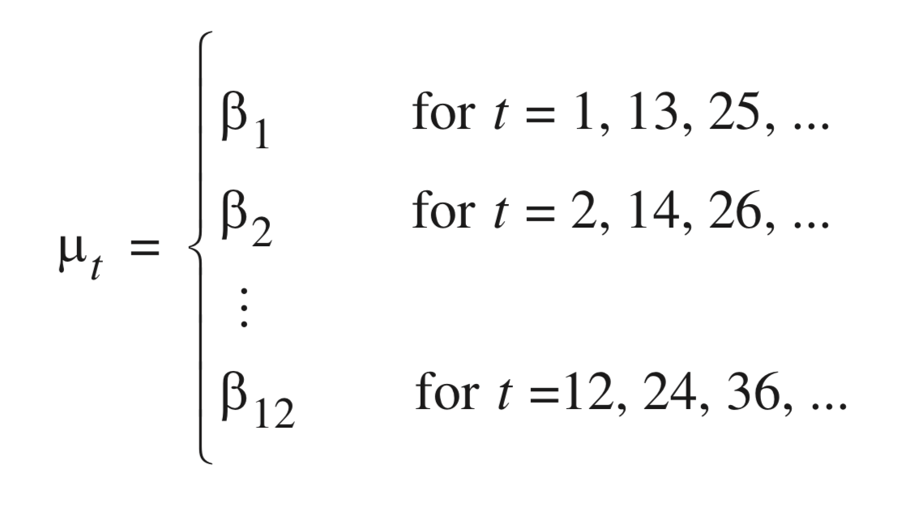
Modeling Trend Cyclical or Seasonal Trends
Represents the series, where E[X_{t}] = 0∀ t
Twelve constant parameters
giving the expected average
temperature for each of the 12
months
Seasonal Means
Notes:
library(TSA)
data(tempdub)
month.=season(tempdub) # period added to improve table display
model2=lm(tempdub~month.-1) # -1 removes the intercept term
summary(model2)

Slide 28
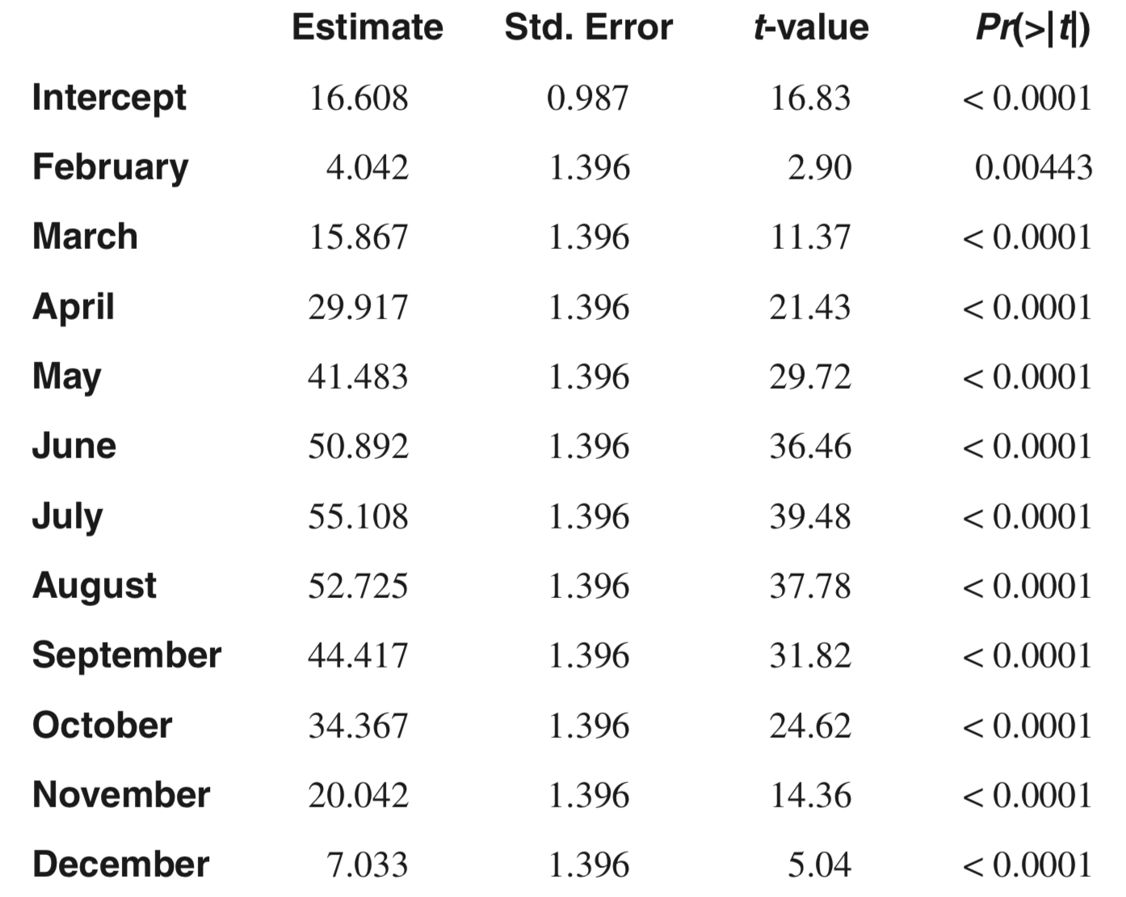
Modeling Trend Cyclical or Seasonal Trends
Notes:
library(TSA)
data(tempdub)
month.=season(tempdub) # period added to improve table display
plot(tempdub,type='o')
model2=lm(tempdub~month.-1) # -1 removes the intercept term
model3=lm(tempdub~month.) # January is dropped automatically
summary(model3)

Slide 29
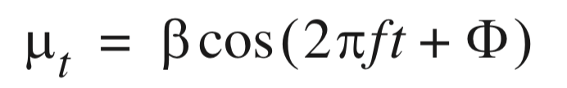
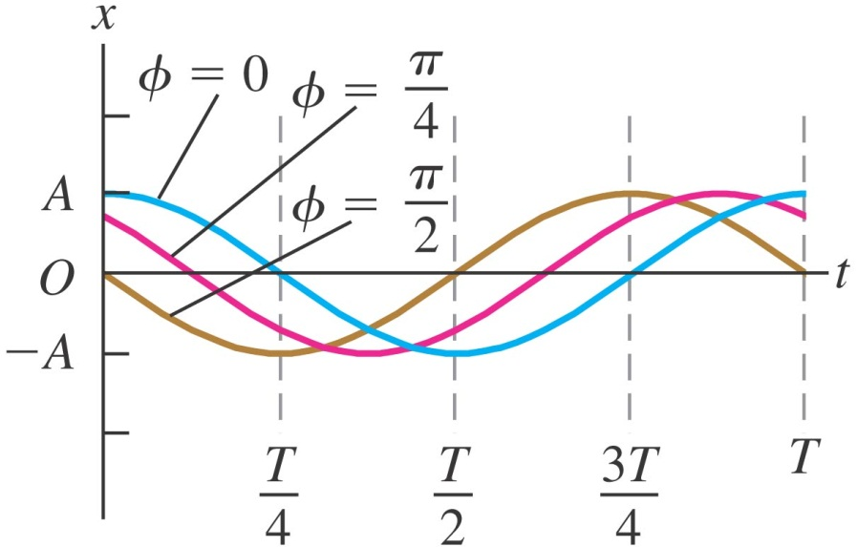
Modeling Trend CosineTrends
Difficult to estimate
because the parameters
𝛽, f and 𝛷 are not linear
Amplitude (A)
Frequency
Phase
Notes:
library(TSA)
data(tempdub)
month.=season(tempdub) # period added to improve table display
model2=lm(tempdub~month.-1) # -1 removes the intercept term
summary(model2)

Slide 30
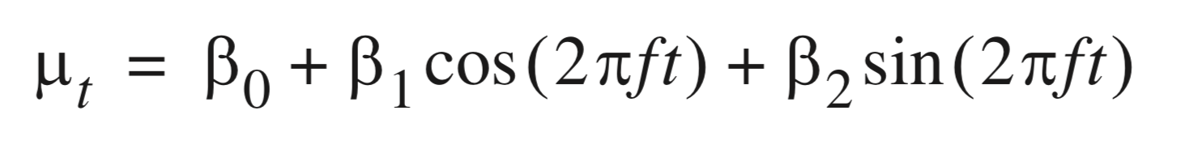
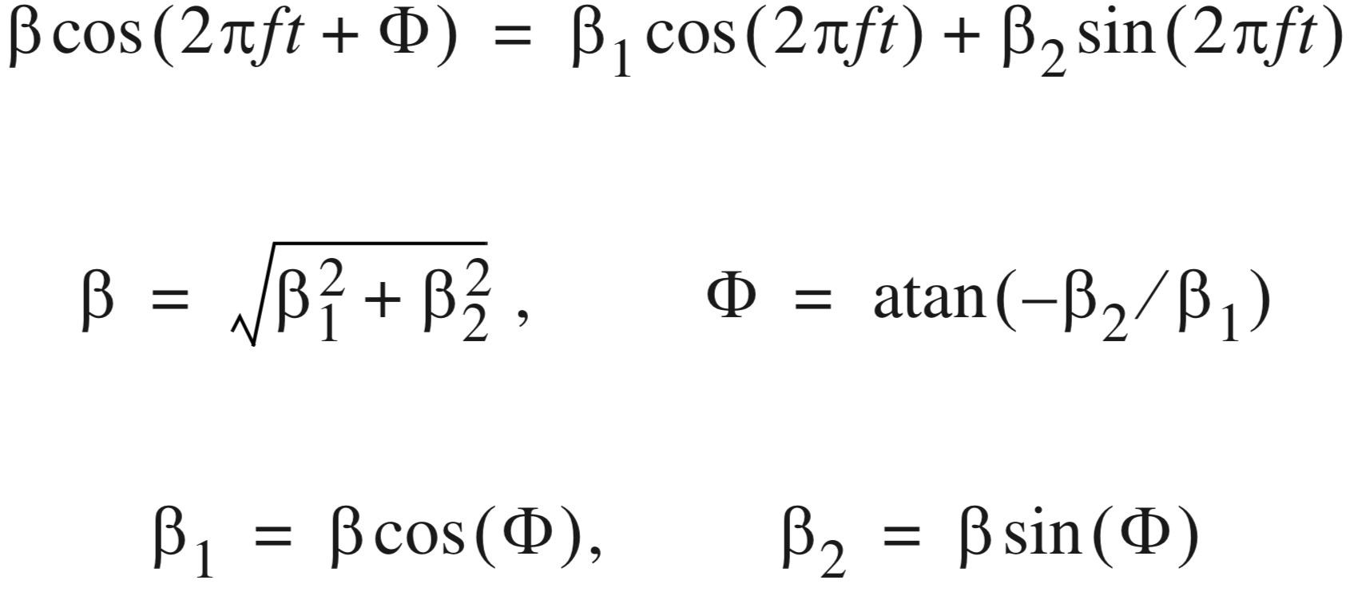
Modeling Trend CosineTrends
Easier model to estimate
Notes:
library(TSA)
data(tempdub)
month.=season(tempdub) # period added to improve table display
model2=lm(tempdub~month.-1) # -1 removes the intercept term
summary(model2)

Slide 31
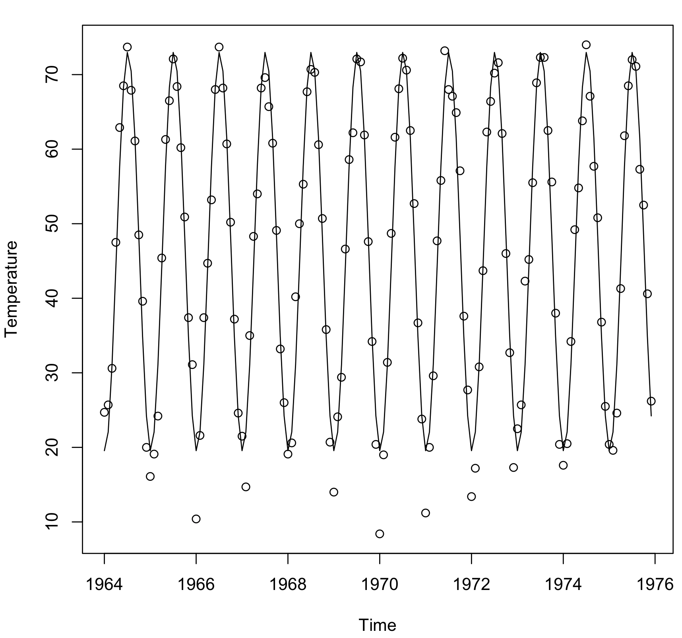
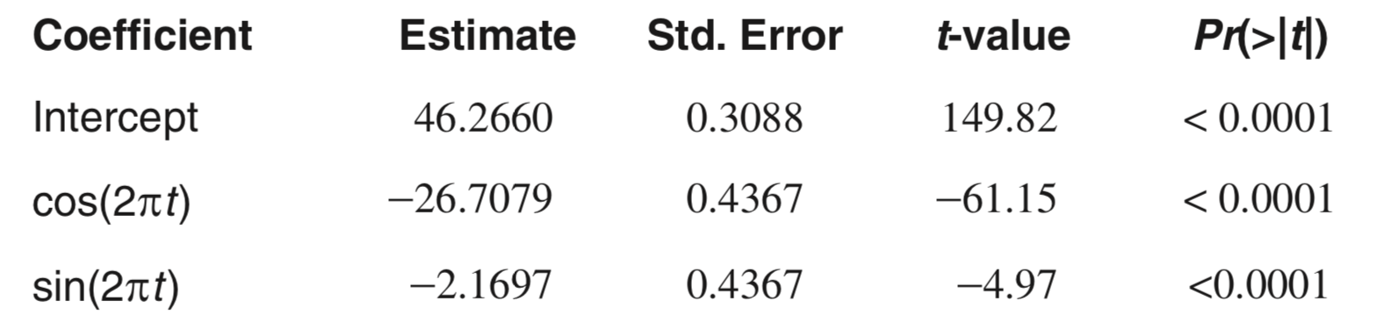
Modeling Trend CosineTrends
Notes:
library(TSA)
data(tempdub)
har.=harmonic(tempdub,1)
model4=lm(tempdub~har.)
summary(model4)
plot(ts(fitted(model4),freq=12,start=c(1964,1)),ylab='Temperature',ylim=range(c(fitted(model4),tempdub)))
points(tempdub)

Slide 32
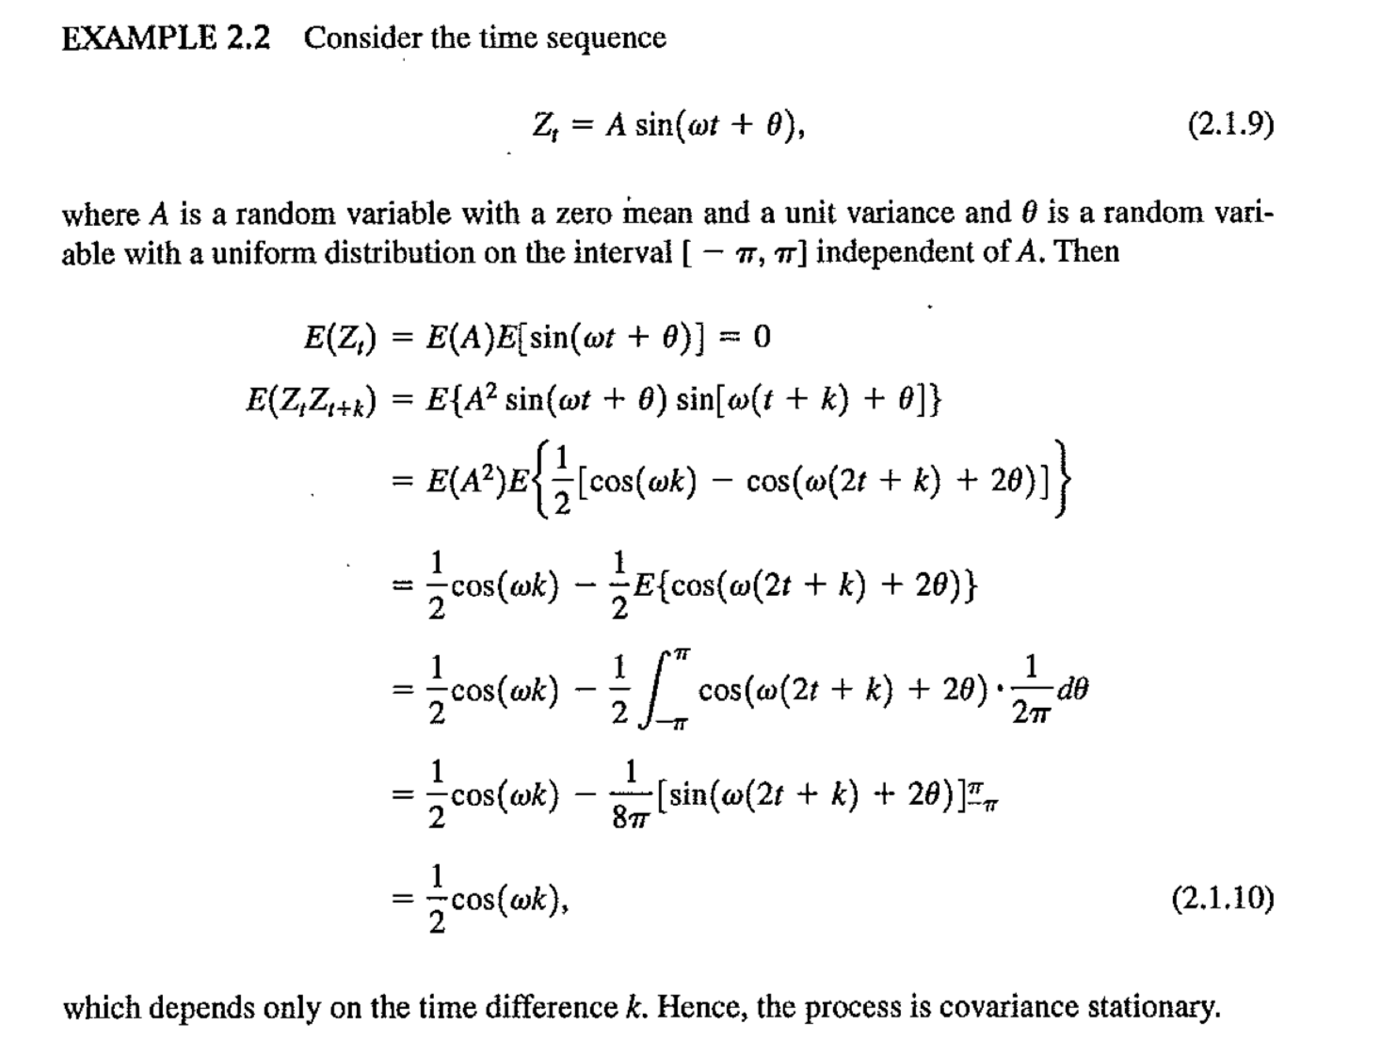
Modeling Trend CosineTrends
Time Series Analysis –W. S. Wei

Slide 33
For Next Class
Readings about today’s class:
Chapter 4ª, 5^{b}
Review Exercises / Problems:
Chapter 5^{b}: 8, 9
Readings for next class:
Chapter 6^{b}: Modeling and Forecasting Seasonality

